Slide 1

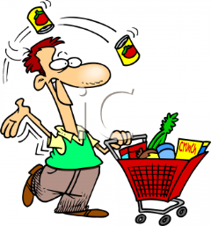

A Trip to the Market
Click Picture Below
Notes:
Throughout the game, the students will work on addition, subtraction as well as some multiplication problems.

Slide 2
Click here to begin our shopping trip!
DIRECTIONS
Read each questions carefully.
Use addition, or multiplication to find the cost for the groceries in the question.
Click on the best answer.
Then subtract the cost of the groceries from your original amount of cash you have to spend.
If answered correctly will then choose money picture to move to next question.
If answered incorrectly, will click on smiley picture and try again.
Notes:
The directions are clearly stated and easy to follow. All links have been activated to begin the game.

Slide 3


You have 40.00$ to spend at the market today.
Be sure not to go over your limit!
Click here to begin
Notes:
Beginning balance will be 40.00 dollars, and will end with a total of .25 cents if done correctly.

Slide 4
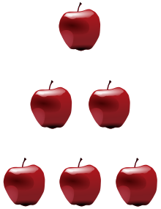
Apples cost .50 cents each.
At the market today you will purchase 10 apples. Decide how much the apples will total, and then click the correct answer below.
A. 2.50$ or
B. 5.00$
Notes:
The player will be given a second chance to guess the correct answer.

Slide 5
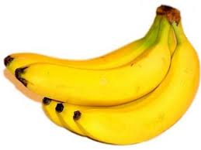
Bananas cost approximately .75 cents each. You will need to purchase 5 bananas…. Choose the correct answer below…..
A. 3.00$ or
B. 3.75$
Good Job, you selected the correct answer!
You now have 35.00$ left, good luck!

Slide 6
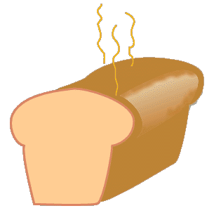
You need to purchase 4 loaves of bread. The loaves cost 2.00$ each. Please choose the correct total cost of the bread below…
A. 8.00$ or
B. 6.00$
Good job, you selected the correct answer! You now have 31.25$left to spend at the market…Good Luck!

Slide 7
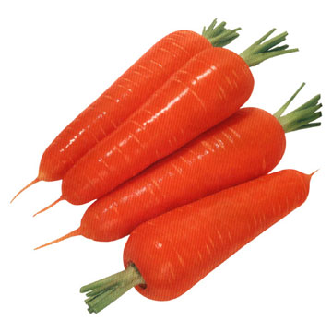
You are making carrot soup tonight and need 20 carrots. Each carrot costs .55 cents. Please choose the correct cost of the carrots below….
A. 10.25$ or
B. 11.00$
Way to go! You are on the right track! You now have 23.25$ left to spend at the market…Keep up the good work!

Slide 8
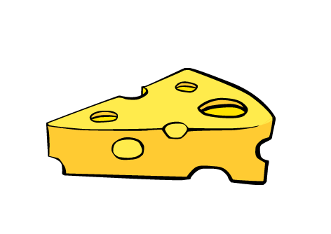
Cheese please! You need to purchase 3 wheels of cheese. Each wheel of cheese will cost you 2.00$. Please choose the correct total cost of the cheese below.
A. 6.00$ or
B. 4.00$
Awesome, you did it! You now have 12.25$ left to spend at the market! You are not yet done shopping, keep up the good work!

Slide 9
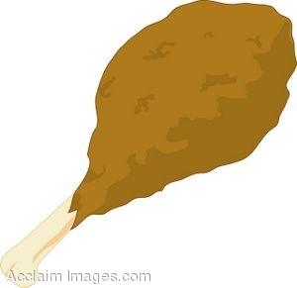
You need chicken for tonight’s feast. Each chicken leg is .50 cents. You will need to purchase 12 chicken legs. Please choose the correct total cost of the chicken legs below.
A. 6.25$ or
B. 6.00$
You are really on a roll! You have only 6.25$ left to spend at the market. You are doing great…Keep up the good work!

Slide 10


You did it again! Wow you are really amazing… You purchased all of your groceries and still saved .25 cents. As a reward You have earned 2 awesome activities below. Click on each picture to begin….Have Fun! Click here to return to beginning!
Click on a smiley face below to get started!

Slide 11
Click the money picture to move to the next question!
Congratulations! You have chosen the correct answer!
10 x .50 = 5.00$
.50+.50+.50+.50+.50+.50+.50+.50+.50+.50 = 5.00$
40.00$
-5.00$
= 35.00$

Slide 12

Sorry that was not the correct answer…Please try again…Better luck this time…
Click on picture to return to the question.

Slide 13
Click on the money picture above to move on to the next question!
Congratulations! You chose the correct answer…
The total price for 5 bananas at .75 cents each is 3.75$...
.75 x 5 = 3.75$ or 35.00
- 3.75
= 32.25$ left to spend
.75
+ .75
.75
.75
.75
= 3.75$

Slide 14
Click on the smiley face above please to return to the question!
Sorry that was not the correct answer…Please try again by clicking on the smiley face below…Thank you and Good Luck!

Slide 15

Please click on the money picture to move to the next question!
Congratulations! The correct answer was 8.00$ for 4 loaves of bread at 2.00$ a piece!
2.00$ x 4 = 8.00$ or 31.25$
- 8.00$
= 23.25$
You now have 23.25$ left to spend!
2.00
+ 2.00
2.00
2.00
= 8.00$

Slide 16
Sorry that was not the correct answer…Please try again…Better luck this time…
Click on picture to return to the question.

Slide 17
Sorry that was not the correct answer…Please try again…Better luck this time…
Click on picture to return to the question

Slide 18
Please click on the money picture to move to the next question.
Congratulations you did it again! The total cost of 20 carrots at .55 cents would cost 11.00$
20 x .55 = 11.00$
.55+.55+.55+.55+.55+.55+.55+.55+.55+.55+.55+.55+.55+.55+.55+.55+.55+.55+.55+.55=
11.00$
23.25$ You now have 12.25$ left to spend!
  11.00$
  = 12.25$

Slide 19
Click on the smiley face above please to return to the question!
Sorry that was not the correct answer…Please try again by clicking on the smiley face below…Thank you and Good Luck!

Slide 20
Please click on the money picture to move to the next question.
Great job! That was the correct answer. The total cost for 3 wheels of cheese at 2.00$ each would cost a total of 6.00$
2.00$ x 3 = 6.00$ or 12.25$
- 6.00$
= 6.25$
2.00$
+ 2.00$
2.00$
= 6.00$

Slide 21
Wow! You did it…You still have .25 cents left and you did not go over your limit…
Please click on the money picture above to complete this assignment!
Congratulations you did it again! The total cost of 12 chicken legs at .50 cents would cost 6.00$
.50 x 12 = 6.00$ or
.50+.50+.50+.50+.50+.50+.50+.50+.50+.50+.50+.50= 6.00$
Your previous total left to spend was 6.25$.
6.25$
- 6.00$
= .25

Slide 22
Click on the smiley face above please to return to the question!
Sorry that was not the correct answer…Please try again by clicking on the smiley face below…Thank you and Good Luck!

